Slide 1
IBM Full Stack Development
Exploring HTML, CSS, and JavaScript Fundamentals
By: Ainadri Mandal

Slide 2
Introduction
This presentation covers the essential aspects of HTML, CSS, and JavaScript for full stack development, including basic structures, styling, and interactive applications. We'll examine a practical example of building a calculator, a keyboard interface, and more advanced projects like an e-commerce platform and a YouTube clone.

Slide 3
HTML & CSS Basics
01

Slide 4
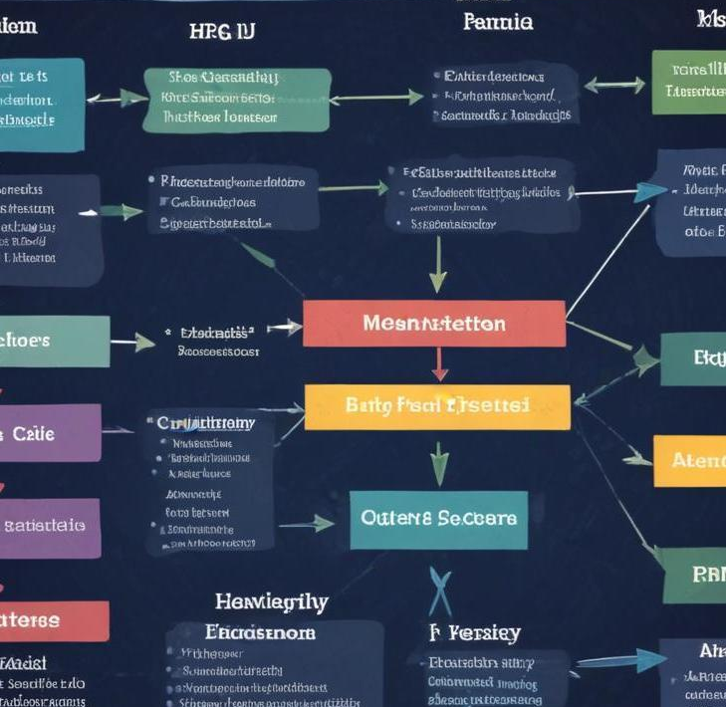
Structure of HTML Documents
HTML documents form the backbone of web pages. They are structured using elements like <html>, <head>, and <body>. Each element has its own role: <head> contains metadata, and <body> holds the visible content. Key structural tags include headings (<h1> to <h6>), paragraphs (<p>), links (<a>), and lists (<ul>, <ol>), which help create a logical flow and hierarchy of information on the page.

Slide 5
Styling with CSS
CSS (Cascading Style Sheets) is used to style HTML documents. It allows developers to define colors, fonts, layouts, and more. CSS can be applied inline, within a <style> tag in the head, or as an external stylesheet. Key concepts include selectors, the box model, flexbox for layout, and media queries for responsive design. Effective styling enhances user experience and accessibility on websites.

Slide 6
Responsive Design Techniques
Responsive design ensures that web applications render well across various devices and screen sizes. This involves using fluid grids, flexible images, and media queries in CSS. Techniques like mobile-first design prioritize layouts for smaller screens before adapting to larger displays. By ensuring that content is accessible and user-friendly on all devices, developers enhance the overall user experience.

Slide 7
02
JavaScript Applications

Slide 8
E-commerce Functionality
JavaScript plays a crucial role in building interactive e-commerce platforms. Features such as product galleries, shopping carts, and real-time price updates enhance user engagement. By utilizing APIs, developers can implement functionalities like payment processing and user authentication, making shopping experiences seamless and efficient. JavaScript frameworks like React or Vue.js can significantly streamline the development of these features.

Slide 9
Creating Interactive Features
Using JavaScript, developers can create dynamic content that responds to user interactions. Event listeners enable functions such as form validation, animations, and pop-up notifications. Techniques like AJAX allow for asynchronous operations, enabling the page to update without refreshing. This interactivity is vital for improving user experience and engagement on websites.

Slide 10

YouTube Clone Overview
Building a YouTube clone with JavaScript involves using APIs for video streaming, user authentication, and data storage. Key elements include creating a user interface with HTML and CSS, implementing functionality for video uploads and comments using JavaScript, and storing video data in a backend database. This project showcases the integration of front-end and back-end technologies to create a full-fledged video platform.

Slide 11
Conclusions
This presentation has highlighted the significance of HTML, CSS, and JavaScript in full stack development. Understanding the structure and styling of HTML/CSS lays the groundwork for building interactive applications with JavaScript. The projects discussed illustrate how these technologies work together to create functional, user-friendly web applications.

Slide 12
Thank you!
Do you have any questions?
Please keep this slide for attribution

